Slide 1
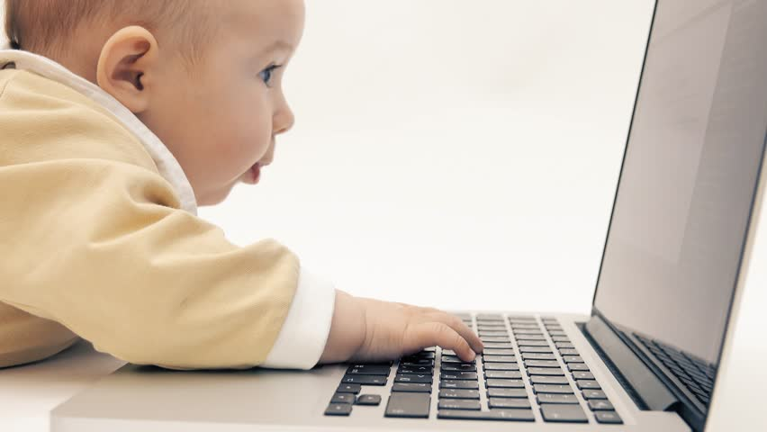

Lil’learn
SMART LEARNING APP
Keep Your Child
One Step Ahead
Made By:
Ayush Pushkarna Sukhbir Singh
Balkar Singh Shrujal

Slide 2

Objectives:
The main aim of this project is to develop an easy-to-use, kid-friendly application which meets their educational needs.
To facilitate brain development during the early years of childhood through engaging virtual activities.
To raise the bar of online learning in today’s world by introducing AirPen and SmartCanvas

Slide 3
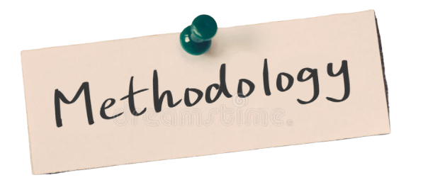
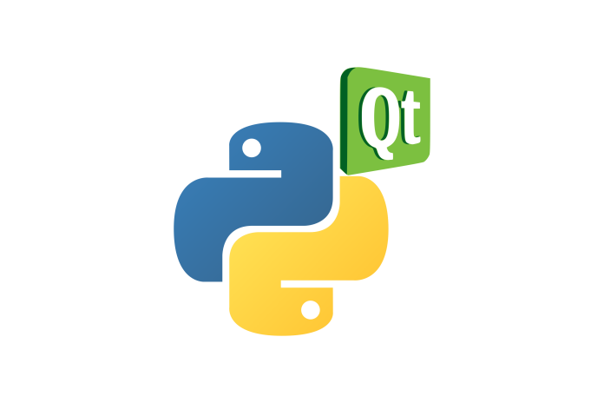
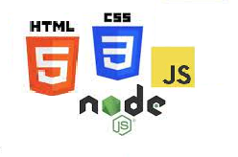
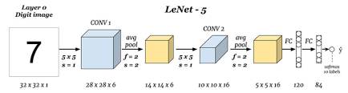


Software developed using PyQt5 Library and used MongoDB to Authenticate the User.
Implementing ML model created using Convolutional Neural Network.
Web Site made using HTML,CSS, Bootstrap,NodeJS and MongoDB server to Register new User and Download the Software
Stored Students scores, star ratings and all the Progress on MongoDB server
Designing of drag and drop GUI and virtual canvas using OpenCV.

Slide 4

Expected Outcomes:
Website accessible software which enables user to download the setup of the software after successful login.
Fully functional software which makes uses virtual pen and eraser for children to use.
Different levels of difficulties which includes drawing alphabet, numbers, and shapes, mathematical operations.
Classifying different types of animals, fruits, uniforms using drag and drop GUI.
Downloadable report cards to keep track of the progress of the child.

Slide 5

Novelty of the Project
We live in an era of innovation and developing technologies. There have been a slew of learning applications introduced to the market in recent years. Nothing, however, comes close to the Lil'Learn app.
It's cutting-edge one-to-one learning software that's jam-packed with never-before-seen technology. Our software has an AirPen feature that allows students to sketch and write their answers in the air with their fingertips. The result is shown on the Smart Canvas.
The child's daily and monthly progress can be monitored by graphs. To keep the child motivated, extra star points are awarded.
One-of-a-kind drag-and-drop in the air games created with keeping in mind "Fun and Learning".
To keep the little ones engaged and the lesson engaging, voice response on each answer has been incorporated, along with background music.

Slide 6


BUDGET:
Hosting Cost:
Domain Privacy Protection: ₹449/year
Website Backup: ₹2388/year
Positive SSL Certificate: ₹3588/year
Website Security Protection: ₹1548/year
Hosting Price: ₹3588/year
Total: ₹11561

Slide 7

Challenges:
Finding the appropriate datasets to train the ML model for alphabet, numbers and shapes prediction.
Improving the accuracy of the ML model for correct predictions.
Getting used to PyQt5 library of python in order to create the GUI of the software.
Establishing the connection of the software with the database.
Restricting multiple device sign-ins of the same user.
Faced the memory buffer issue while deployment of the software.
Correct prediction of words drawn on canvas from the pictures shown to the user.
Creating a drag and drop functionality using web cam.

Slide 8
Applications of the Project
According to the UNICEF’s data, COVID-19 lockdowns have forced the closure of schools for more than 168 million children around the world for nearly a year. The longer schools are closed, the more children will be cut off from the important aspects of childhood.
It is well-known that young minds develop the most during the age of 3-10. Thus it is essential to pay attention towards their growth and development. In order to contribute towards the development of their young minds and enhance their intellect we have come up with an application that will aid their learning process.
A keen thought has been given to the fact that the main users of the application would be students of pre-school to kindergarten and their parents. Thus the user interface is very engaging in nature as well as interactive. Moreover Lil' learn is easy to operate and a fascinating platform for kids which will keep them busy in a good way.
The activities have been designed in such a manner to let the child become familiar with different types of fruits, animals, uniforms etc. through drag and drop activities.

Slide 9
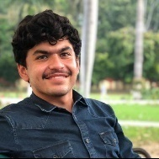
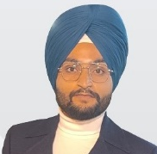
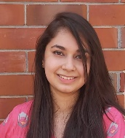
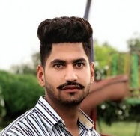
Team Lil’learn
Members Roles | Ayush Pushkarna | Sukhbir Singh | Shrujal | Balkar Singh
Web Layout and Frontend |  | ✔
Authentication and API’s access |  | ✔ |  | ✔
Software Database Connection & Authentication | ✔ | ✔
Software GUI Development | ✔ |  | ✔
NodeJS Programming |  | ✔ |  | ✔
Database Connection Setup |  | ✔ |  | ✔
Generating ML Models | ✔ |  | ✔
AirPen and SmartCanvas | ✔
Object Drag and Drop App | ✔ |  | ✔
Dashboard & other Utilities | ✔ |  | ✔
Backend Programming & Software Setup | ✔
Documentation & Diagrams |  |  | ✔ | ✔
Content & Video | ✔ | ✔ | ✔

Slide 10
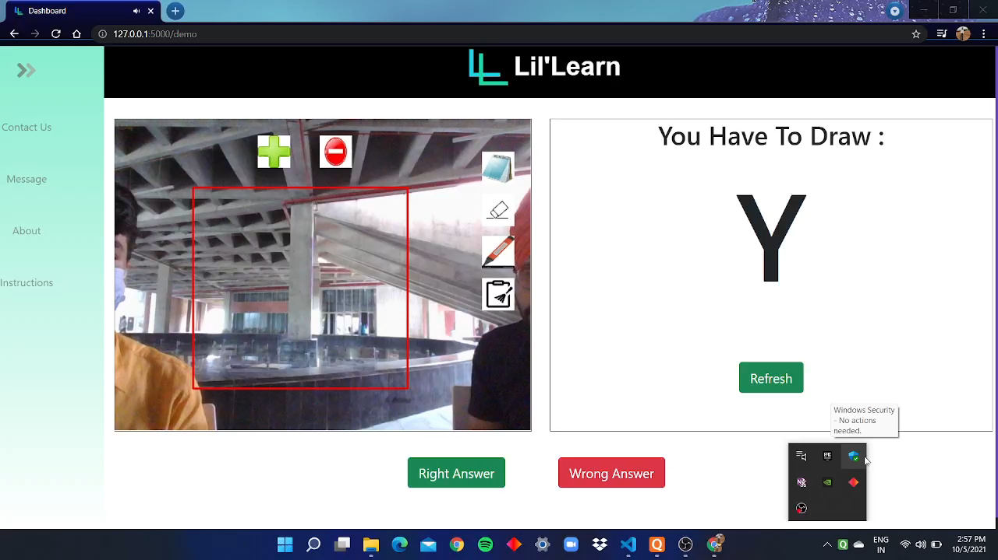
Demo Video

Slide 11


